Slide 1
Technologies prior to DHCP
BOOTP
RARP
ARP
ARP (RFC826)
Address Resolution Protocol
Maps known IP address to
unknown MAC address
RARP (RFC903)
Reverse ARP
Early protocol for dynamic IP address assignment
Very limited – does not support assigning name servers and default gateway.
BOOTP (BOOTstrap Protocol)
Defined to overcome the limitations of RARP.

Slide 2
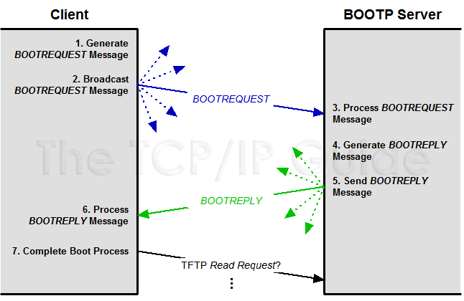
BOOTP
Client Creates Request
Client Sends Request
Server Receives Request and Processes it
Server Creates Reply
Server Sends Reply
Client Processes Reply
Client Completes Boot Process

Slide 3
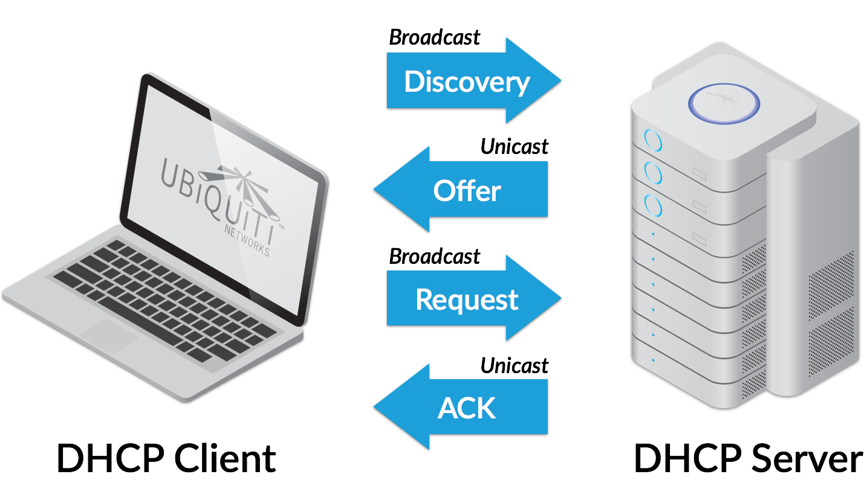
Leasing an IP Address
DORA
An IP Address is leased during the boot process.
The overall process is composed of 4 broadcast packets :
DHCPDISCOVER (1)
DHCPOFFER (2)
DHCPREQUEST (3)
DHCPACK (5)

Slide 4
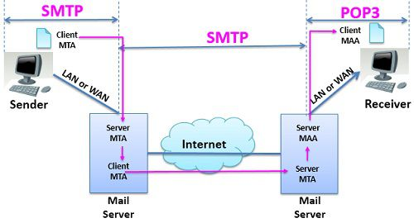
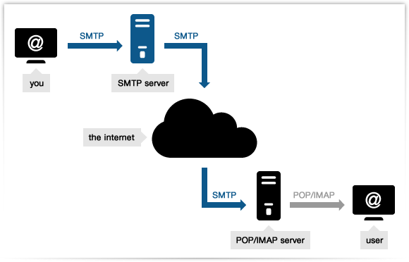
Overview : SMTP

Slide 5
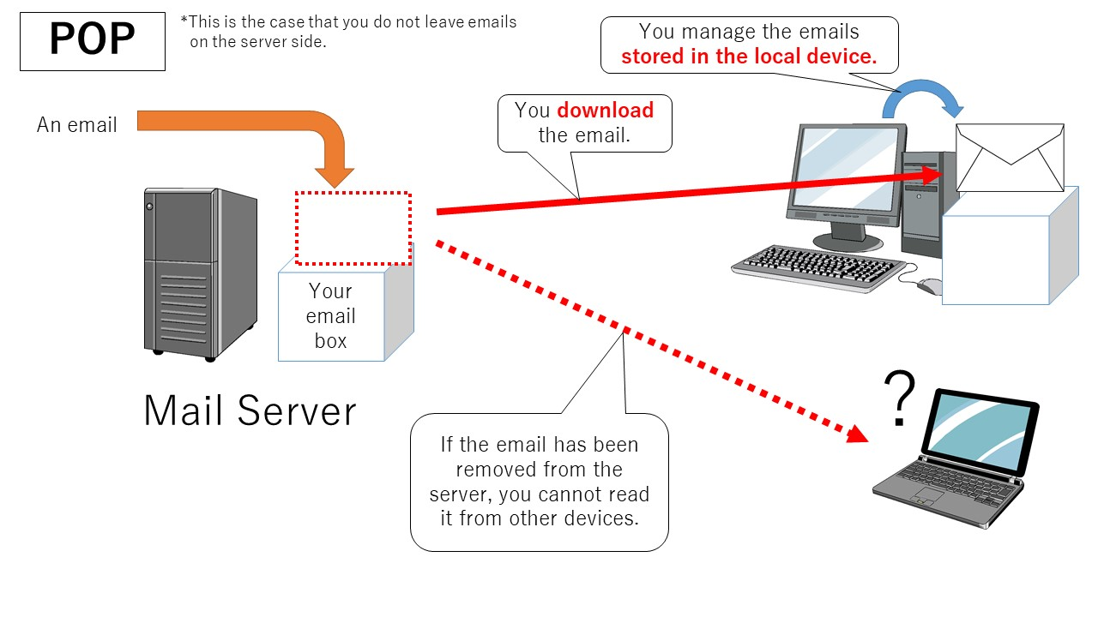
Overview : POP3

Slide 6
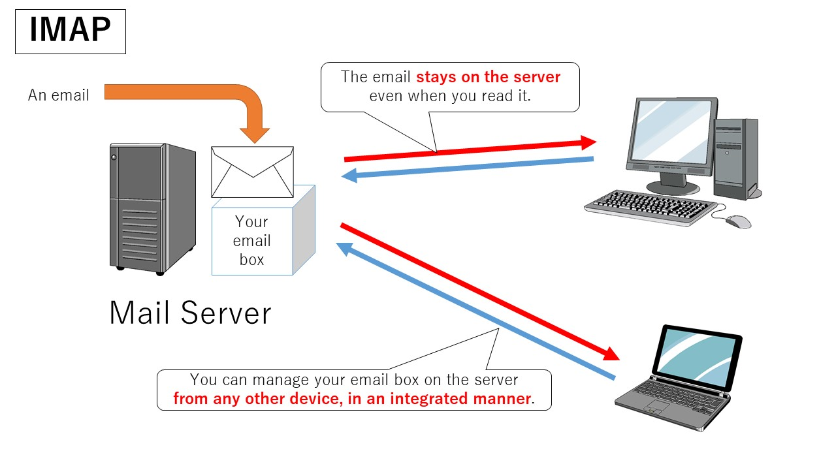
Overview : IMAP

